Slide 1

Apartment Management System
BUAN 6320- DATABASE FOUNDATION FOR BUSINESS ANALYTICS
Group 12
M. Dash, T. Raman, V. Sonje, T. Takatani

Slide 2
Objective
To efficiently and effectively manage various aspects of apartment complexes or residential properties.
Apartment Management: Capture and oversee comprehensive data for each apartment.
Tenant Management: Store and manage detailed information about each tenant.
Maintenance Tracking: Manage and track maintenance requests for every apartment, including the status of the request and the staff assigned against it.
Staff Management: Store and manage details about each staff who is part of the apartment complexes.
Payment Processing: Maintain a record of payment history for each tenant along with payment method and fine calculations.

Slide 3
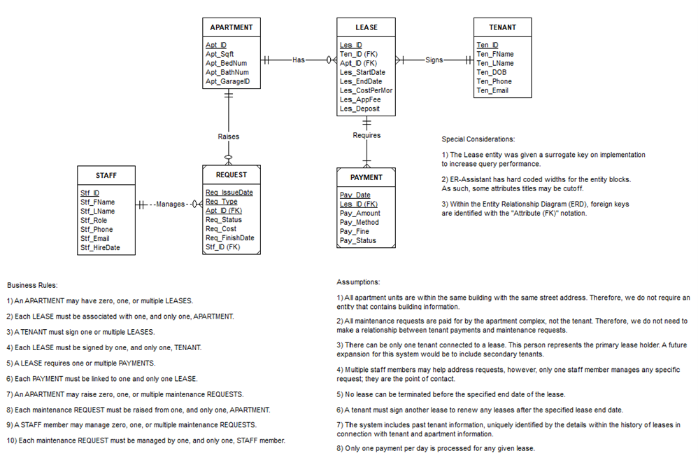
Entity Relationship Diagram

Slide 4
Example Trigger
CREATE OR REPLACE FUNCTION insert_trigger() RETURNS TRIGGER AS $$ BEGIN -- Set created_by to the current user if it's null IF NEW.created_by IS NULL THEN NEW.created_by := current_user; END IF; -- Set created_date to the current timestamp if it's null IF NEW.created_date IS NULL THEN NEW.created_date := NOW(); END IF; -- Set updated_by to the current user if it's null IF NEW.updated_by IS NULL THEN NEW.updated_by := current_user; END IF; -- Set updated_date to the current timestamp if it's null IF NEW.updated_date IS NULL THEN NEW.updated_date := NOW(); END IF; RETURN NEW; END; $$ LANGUAGE plpgsql;
'set_apt_defaults' Trigger calls this function

Slide 5
Example Sequence
DROP SEQUENCE IF EXISTS stf_id_seq;
CREATE SEQUENCE stf_id_seq
START WITH 1
INCREMENT BY 1
MINVALUE 1;
CREATE OR REPLACE FUNCTION stf_insert_trigger()
RETURNS TRIGGER AS $$
BEGIN
-- Set ten_id to the next value in the sequence
NEW.stf_id = NEXTVAL('stf_id_seq');
-- Set created_by to the current user if it's null
IFNEW.created_by IS NULL THEN
NEW.created_by := current_user;
END IF;
Implementation of Triggers and Sequences

Slide 6
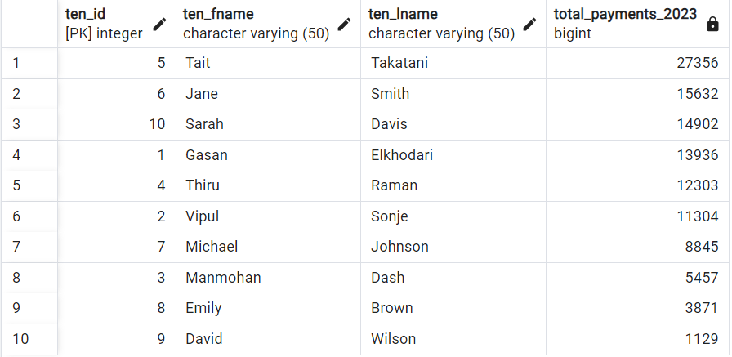
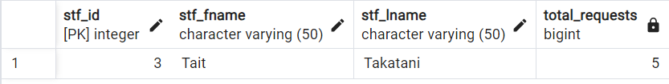
Advance Queries
TASK: Calculate the total payments made by each tenant for the year 2023, including fines.
Business Implication: This query helps in understanding the financial contributions of each tenant for the year 2023, including lease payments and fines.
SELECT
tenant.ten_id,
ten_fname,
ten_lname,
SUM(pay_amount + pay_fine) AS total_payments_2023
FROM tenant
LEFT JOIN lease ON tenant.ten_id = lease.ten_id
LEFT JOIN payment ON lease.les_id = payment.les_id
WHERE EXTRACT(YEAR FROM pay_date) = 2023
GROUP BY tenant.ten_id
ORDER BY total_payments_2023 DESC;
TASK: Find the staff member who has completed the most requests, including In-Progress and completed requests.
Business Implication: This query helps identify the most productive staff member in handling service requests, which can be used for performance evaluation.
SELECT
staff.stf_id,
stf_fname,
stf_lname,
COUNT(request.req_issuedate) AS total_requests
FROM staff
LEFT JOIN request ON staff.stf_id = request.stf_id
WHERE (request.req_status ILIKE ('Finished')
OR
request.req_status ILIKE ('In-Progress'))
GROUP BY staff.stf_id
ORDER BY total_requests DESC
LIMIT 1;

Slide 7
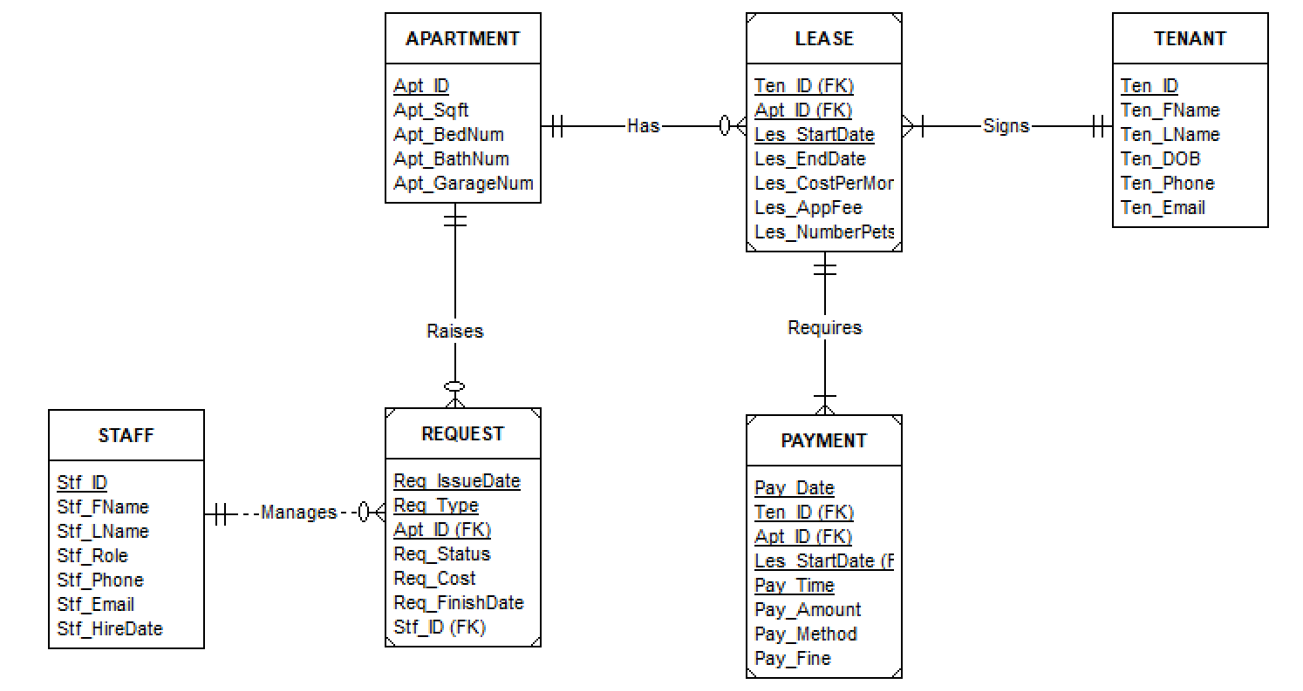
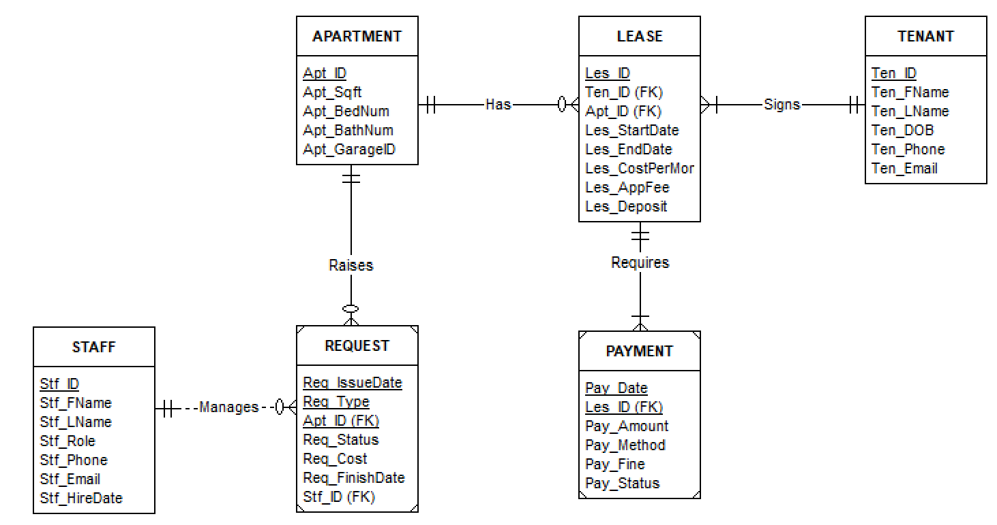

Challenges
Original Concept
Implemented Concept
Lease has three attributes contributing to the composite primary key.
Payment inherits the composite key from Lease
Replaced the composite primary key in Lease with a surrogate key.
Payment references Lease only through Les_ID.
Consequence:
Multi-attribute composite primary keys for Payment and Lease lead to more complex queries and joins.
Consequence:
Simplifies queries and joins, however conceptually turns Lease into a strong entity.

Slide 8


Thank You

